Slide 1
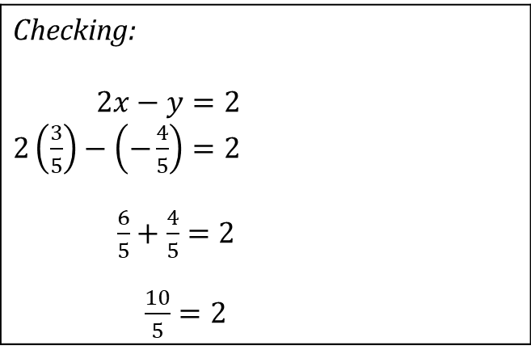


Simultaneous Equations
$3x+y=1……..\left(1\right)$
$2x−y=2……..(2)$
By elimination:
$\left(1\right)+\left(2\right)$
$5x=3$
$∴x=\frac{3}{5}$
$3x+y=1$
$3\left(\frac{3}{5}\right)+y=1$
$\frac{9}{5}+y=1$
$∴y=1−\frac{9}{5}=\frac{5−9}{5}$
$=−\frac{4}{5}$
By substitution:
$3x+y=1$
$y=1−3x$……..$\left(3\right)$
$2x−\left(1−3x\right)=2$
$2x−1+3x=2$
$5x=3$
$∴x=\frac{3}{5}$
$y=1−3x=1−3\left(\frac{3}{5}\right)$
$=1−\frac{9}{5}$
$=−\frac{4}{5}$
Checking: $2x−y=2$ $2\left(\frac{3}{5}\right)−\left(−\frac{4}{5}\right)=2$ $\frac{6}{5}+\frac{4}{5}=2$ $\frac{10}{5}=2$

Slide 2

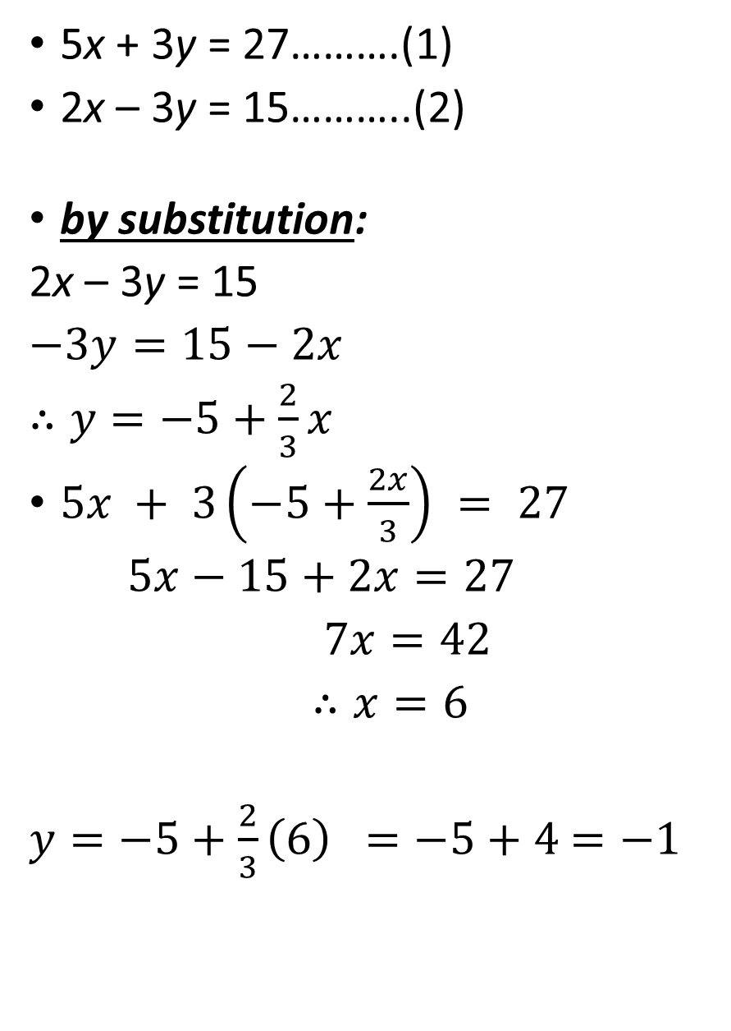
.
5x + 3y = 27……….(1)
2x – 3y = 15………..(2)
by substitution:
2x – 3y = 15
$−3y=15−2x$
$∴y=−5+\frac{2}{3}x$
$5x + 3\left(−5+\frac{2x}{3}\right) = 27$
$5x−15+2x=27$
$7x=42$
$∴x=6$
$y=−5+\frac{2}{3}\left(6\right)$ $=−5+4$ $=−1$
By elimination:
5x + 3y = 27……….(1)
2x – 3y = 15………(2)
+ (2)
$7x=42$
$∴x=\frac{42}{7}=6$
$5\left(6\right) + 3y = 27$
$30+3y=27$
$3y=−3$
$∴y=−1$

Slide 3
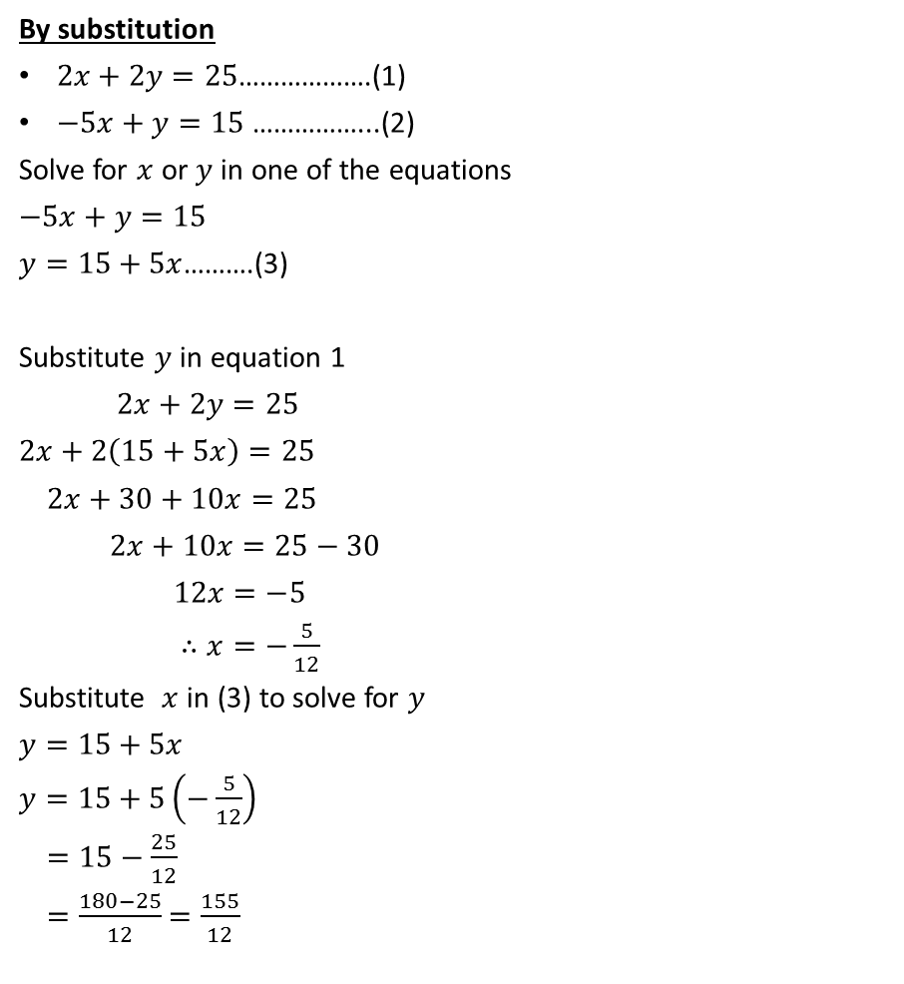
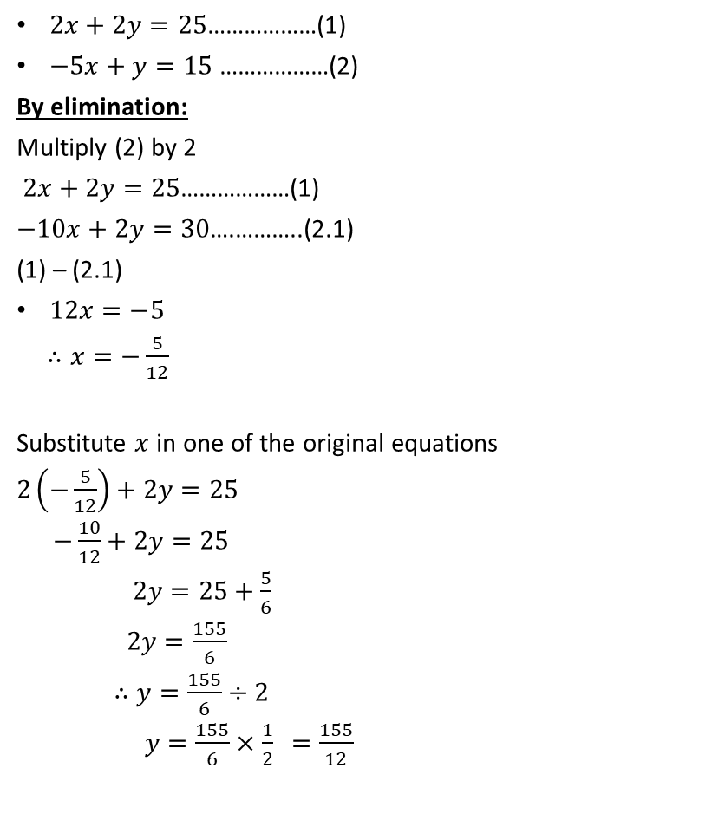
Simultaneous Equations:
$2x+2y=25$………………(1)
$−5x+y=15$ ………………(2)
By elimination:
Multiply (2) by 2
$2x+2y=25$………………(1)
$−10x+2y=30$….………..(2.1)
(1) – (2.1)
$12x=−5$
$∴x=−\frac{5}{12}$
Substitute $x$ in one of the original equations
$2\left(−\frac{5}{12}\right)+2y=25$
$−\frac{10}{12}+2y=25$
$2y=25+\frac{5}{6}$
$2y=\frac{155}{6}$
$∴y=\frac{155}{6}÷2$
$y=\frac{155}{6}×\frac{1}{2}$ $=\frac{155}{12}$
By substitution
$2x+2y=25$……………….(1)
$−5x+y=15$ ……………...(2)
Solve for $x$ or $y$ in one of the equations
$−5x+y=15$
$y=15+5x$……….(3)
Substitute $y$ in equation 1
$2x+2y=25$
$2x+2\left(15+5x\right)=25$
$2x+30+10x=25$
$2x+10x=25−30$
$12x=−5$
$∴x=−\frac{5}{12}$
Substitute $x$ in (3) to solve for $y$
$y=15+5x$
$y=15+5\left(−\frac{5}{12}\right)$
$=15−\frac{25}{12}$
$=\frac{180−25}{12}$ $=\frac{155}{12}$

Slide 4
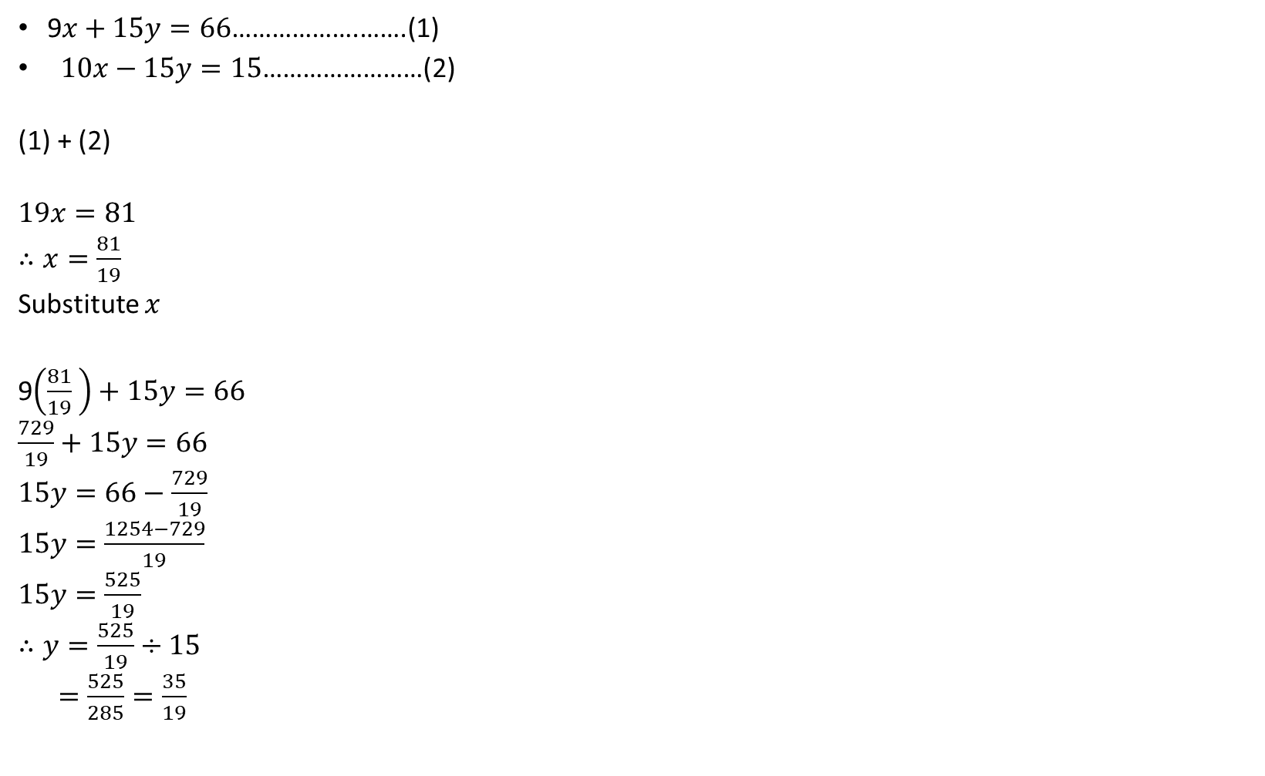
Simultaneous Equations
9$x+15y=66$……………….…….(1)
$10x−15y=15$……………………(2)
(1) + (2)
$19x=81$
$∴x=\frac{81}{19}$
Substitute $x$
9$\left(\frac{81}{19} \right)+15y=66$
$\frac{729}{19}+15y=66$
$15y=66−\frac{729}{19}$
$15y=\frac{1254−729}{19}$
$15y=\frac{525}{19}$
$∴y=\frac{525}{19}÷15$
$=\frac{525}{285}=\frac{35}{19}$

Slide 5
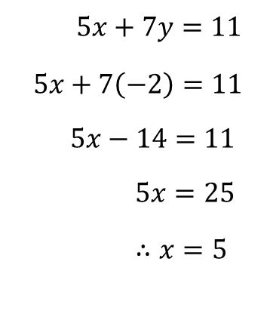
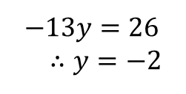

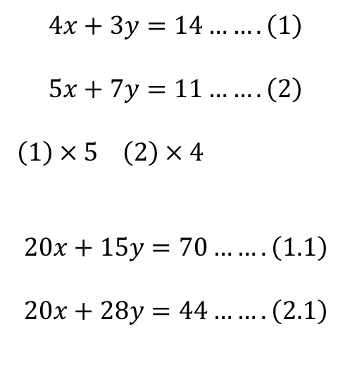
$$4x+3y=14…….\left(1\right)$$
$$5x+7y=11…….\left(2\right)$$
$\left(1\right)×5$ $\left(2\right)×4$
$$20x+15y=70…….\left(1.1\right)$$
$$20x+28y=44…….\left(2.1\right)$$
$5x+7y=11$
$$5x+7\left(−2\right)=11$$
$5x−14=11$
$5x=25$
$∴x=5$
$$\left(1.1\right)−2.1$$
$−13y=26$
$∴y=−2$

Slide 6
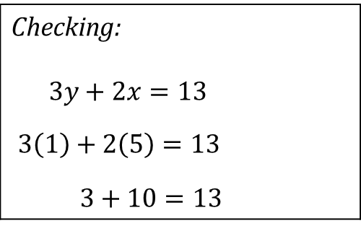
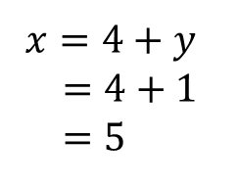
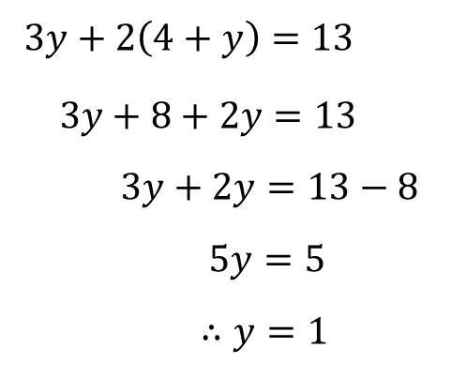

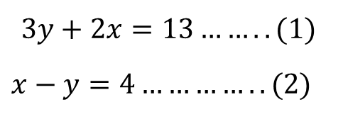
$$3y+2x=13…….. (1)$$
$x−y=4…………..(2)$
$x=4+y$
$=4+1$
$=5$
Checking: $3y+2x=13$ $3\left(1\right)+2\left(5\right)=13$ $3+10=1$3
$$x=4+y…………(3)$$
$3y+2\left(4+y\right)=13$
$3y+8+2y=13$
$3y+2y=13−8$
$5y=5$
$∴y=1$

Slide 7
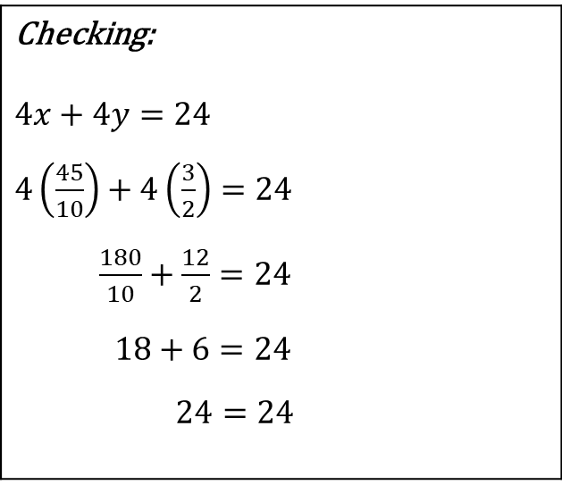
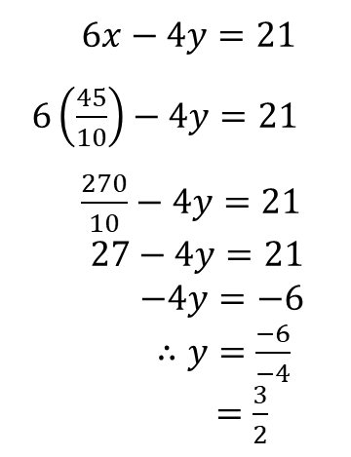
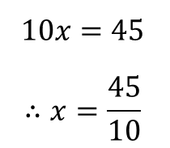

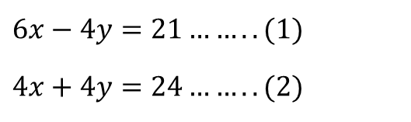
$6x−4y=21……..(1)$
$4x+4y=24……..(2)$
$6x−4y=21$
$6\left(\frac{45}{10}\right)−4y=21$
$\frac{270}{10}−4y=21$
$27−4y=21$
$−4y=−6$
$∴y=\frac{−6}{−4}$
$=\frac{3}{2}$
Checking: $4x+4y=24$ $4\left(\frac{45}{10}\right)+4\left(\frac{3}{2}\right)=24$ $\frac{180}{10}+\frac{12}{2}=24$ $18+6=24$ $24=24$
$$\left(1\right)+(2)$$
$$10x=45$$
$$∴x=\frac{45}{10}$$

Slide 8
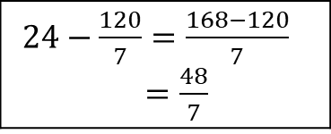

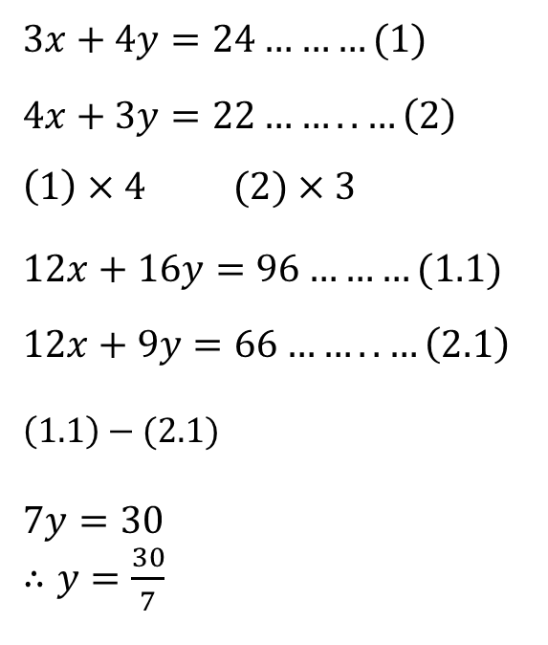
$3x+4y=24………(1)$
$4x+3y=22……..…\left(2\right)$
$\left(1\right)×4$ $(2)×3$
$12x+16y=96………(1.1)$
$12x+9y=66……..…\left(2.1\right)$
$\left(1.1\right)−(2.1)$
$7y=30$
$∴y=\frac{30}{7}$
$3x+4y=24$
$3x+4\left(\frac{30}{7}\right)=24$
$3x+\frac{120}{7}=24$
$3x=24−\frac{120}{7}$
$3x=\frac{48}{7}$
$∴x=\frac{48}{7}÷3$
$=\frac{48}{7}×\frac{1}{3}$
$=\frac{48}{21}$
$=\frac{16}{7}$
$24−\frac{120}{7}=\frac{168−120}{7}$ $=\frac{48}{7}$

Slide 9

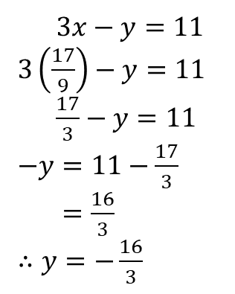
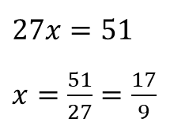



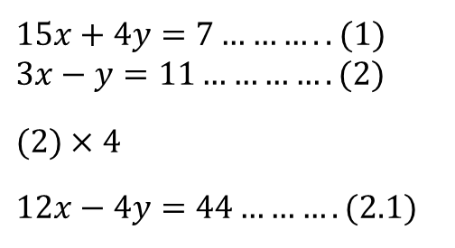
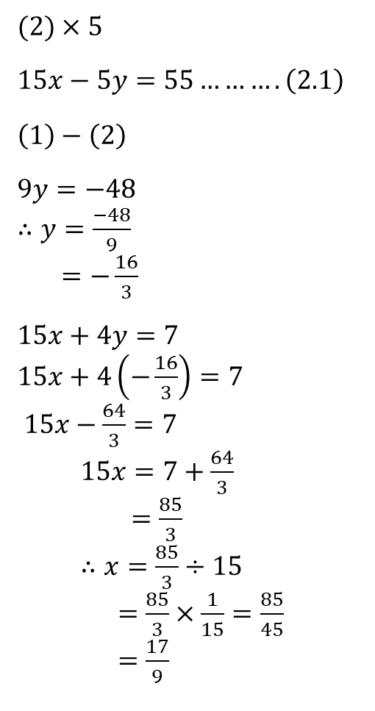
$15x+4y=7………..(1)$
$3x−y=11………….(2)$
$(2)×4$
$12x−4y=44……….(2.1)$
$(2)×5$
$15x−5y=55……….\left(2.1\right)$
$\left(1\right)−\left(2\right)$
$9y=−48$
$∴y=\frac{−48}{9}$
$=−\frac{16}{3}$
$15x+4y=7$
$15x+4\left(−\frac{16}{3}\right)=7$
$15x−\frac{64}{3}=7$
$15x=7+\frac{64}{3}$
$=\frac{85}{3}$
$∴x=\frac{85}{3}÷15$
$=\frac{85}{3}×\frac{1}{15}=\frac{85}{45}$
$=\frac{17}{9}$
Solving for $y$ 1st
$$\left(1\right)+(2.1)$$
$27x=51$
$x=\frac{51}{27}=\frac{17}{9}$
$=\frac{21+64}{3}=\frac{85}{3}$
$3x−y=11$
$3\left(\frac{17}{9}\right)−y=11$
$\frac{17}{3}−y=11$
$−y=11−\frac{17}{3}$
$=\frac{16}{3}$
$∴y=−\frac{16}{3}$
$\frac{33−17}{3}=\frac{16}{3}$

Slide 10

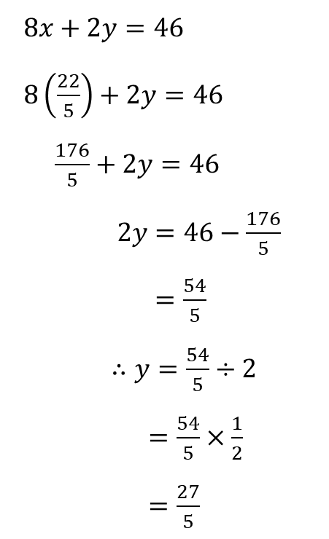
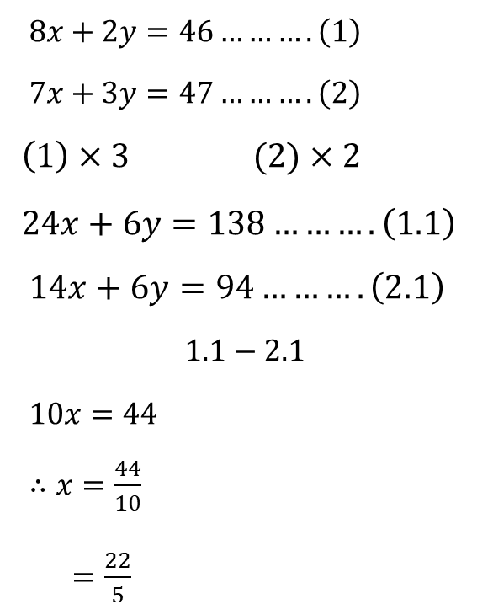
$8x+2y=46……….\left(1\right)$
$7x+3y=47……….\left(2\right)$
$\left(1\right)×3 (2)×2$
$24x+6y=138……….\left(1.1\right)$
$14x+6y=94……….\left(2.1\right)$
$$1.1−2.1$$
$10x=44$
$∴x=\frac{44}{10}$
$=\frac{22}{5}$
$8x+2y=46$
$8\left(\frac{22}{5}\right)+2y=46$
$\frac{176}{5}+2y=46$
$2y=46−\frac{176}{5}$
$=\frac{54}{5}$
$∴y=\frac{54}{5}÷2$
$=\frac{54}{5}×\frac{1}{2}$
$=\frac{27}{5}$
$\frac{230−176}{5}=\frac{54}{5}$

Slide 11


$8x+2y=46……….\left(1\right)$
$7x+3y=47……….\left(2\right)$
$8x+2y=46$
$2y=46−8x$
$y=23−4x……….(3)$
$7x+3y=47$
$7x+3(23−4x)=47$
$7x+69−12x=47$
$−5x=−22$
$∴x=\frac{−22}{−5}$
$=\frac{22}{5}$
$y=23−4x$
$=23−4\left(\frac{22}{5}\right)$
$=23−\frac{88}{5}$
$=\frac{115−88}{5}$
$=\frac{27}{5}$

